Slide 1
Customer Segmentation & Revenue Analysis
Tools: Python, K-Means Clustering, Power BI
Author: Vikram Bhagnani

Slide 2
Business Problem Objective of the Project
Analyze customer purchasing behavior using retail transaction data
Identify product categories where discounts should be applied
Evaluate spending patterns across age, season, and location
Segment customers to enable targeted marketing strategies

Slide 3
Dataset Overview
Dataset contains 3900 customer transactions
Key variables: Age, Category, Purchase Amount, Review Rating
Includes Season, Location, Subscription Status, Payment Method
Data used to understand purchasing patterns and customer behavior

Slide 4
Data Preparation Data Cleaning & Feature Engineering
• Checked for missing values and duplicates • Created Age Group feature for demographic analysis • Aggregated customer-level data for clustering • Standardized variables before applying clustering

Slide 5
Exploratory Data Analysis (EDA)
Revenue distribution analyzed across product categories
Spending behavior evaluated across age groups
Seasonal trends and location impact analyzed
Identified major contributors to overall revenue

Slide 6
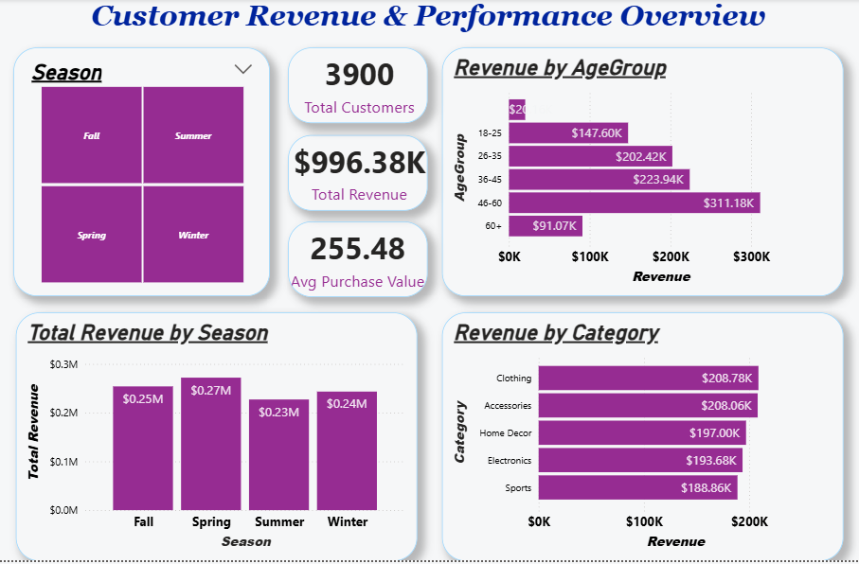
Revenue Insights Dashboard

Slide 7
Insights
Customers aged 46–60 generate the highest revenue
Clothing and Accessories contribute the most sales
Spring season shows the highest revenue

Slide 8
Discount Strategy Recommendation Where Discounts Should Be Applied
Based on category analysis:
• Clothing category responds strongly to discounts • Accessories and Home Decor already perform well without heavy discounts
Recommendation:
Apply targeted discounts to Clothing to increase conversion and basket size.

Slide 9
Customer Segmentation Approach Clustering Methodology
Customer-level dataset created by aggregating transaction data
Features standardized before clustering
K-Means clustering applied to identify customer segments
Optimal number of clusters selected using Elbow Method

Slide 10
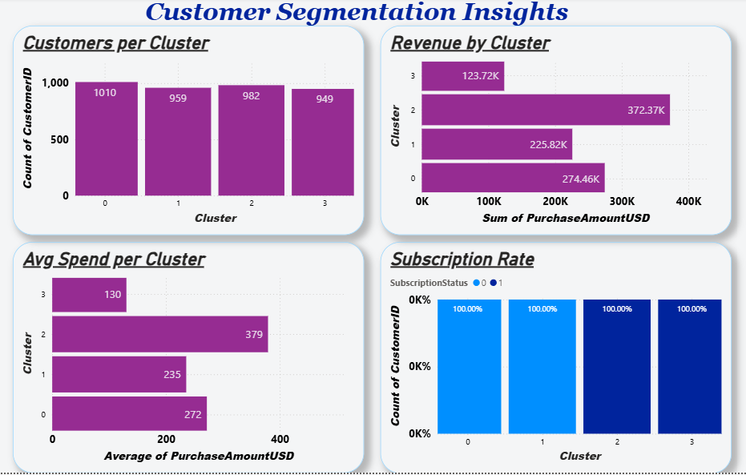
Customer Segmentation Dashboard

Slide 11
Insights from clustering:
Cluster 2 customers show the highest average purchase value
Cluster 3 customers contribute the lowest revenue

Slide 12
Cluster Profiles
Cluster | Description
Cluster 2 | High-value customers
Cluster 0 | Regular customers
Cluster 1 | Moderate spenders
Cluster 3 | Low-value customers

Slide 13
Marketing Strategy Recommended Business Actions
Focus loyalty programs on high-value customers
Offer targeted promotions to moderate spenders
Create engagement campaigns for low-value customers
Goal: Increase customer lifetime value.

Slide 14
Business Impact Expected Business Benefits
Improved customer targeting
Better marketing ROI
Increased customer retention
Data-driven decision making

Slide 15
Conclusion Project Summary
Identified key revenue drivers
Segmented customers using machine learning
Developed actionable marketing strategies
This approach enables businesses to increase revenue and improve customer engagement.

Slide 16
THANK YOU

